Slide 1
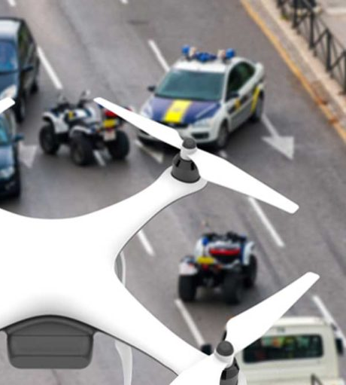
Drone Based Traffic Monitoring System
Hamza Farooq (2020-MSCS-513)
Komal Shehzadi (2020-MSCS-590)

Slide 2
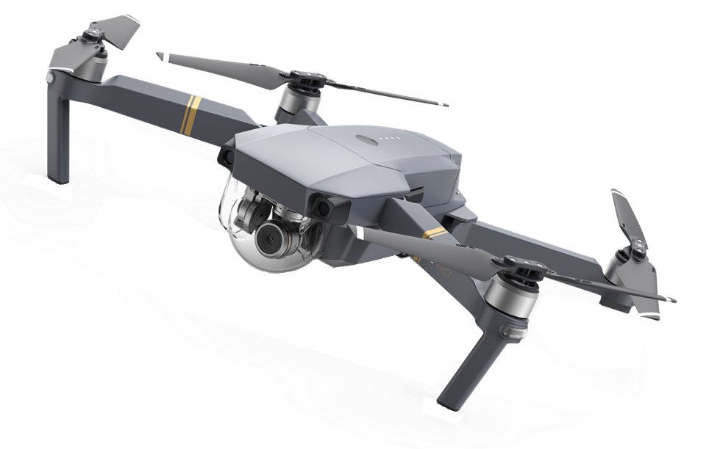
Abstract
Unmanned Aerial Vehicles (UAVs) or “Drones” have gained attention among the public and private sectors. Practical applications such as facility inspection, mapping, surveillance, delivery, etc. have been intensively tested. The focus is to explore the feasibility of using UAV to accelerate the site surveying at major traffic monitoring and management system with comprehensive tracking and detection algorithms. With each technique, the respective use case is also discussed. A prototype UAV system that can be rapidly deployed in the field for video-based site surveying and 3D reconstruction of accident sites has also been proposed.

Slide 3
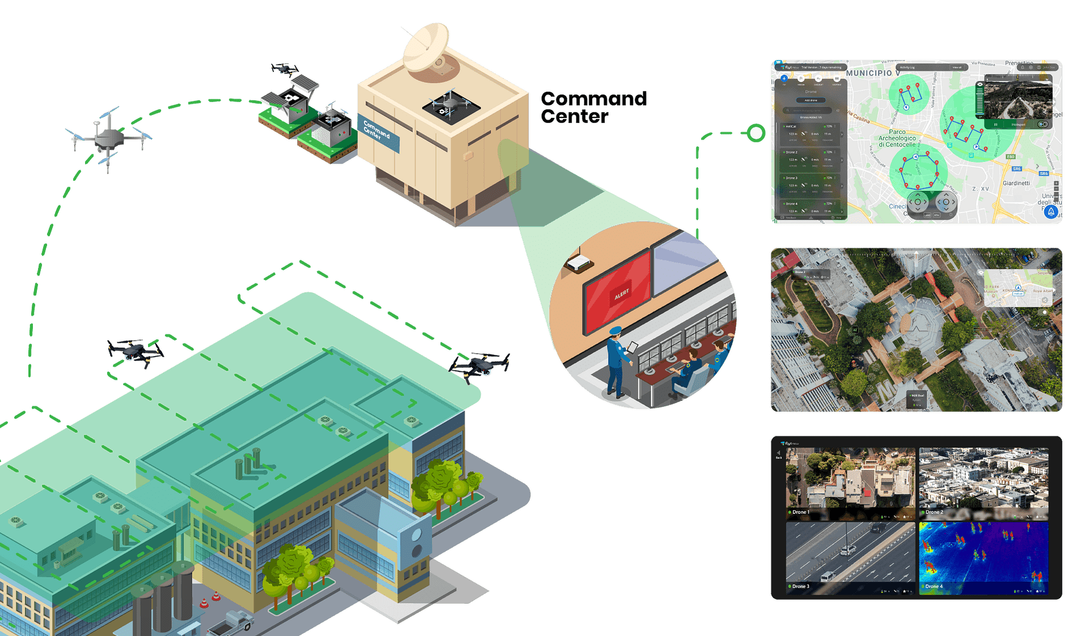
Introduction
The traffic jam is a daily-life problem in any metropolitan city. With the rise of standard of living, the number of vehicles is increasing at an exponential rate. In response to this, many research and practical implementation are done in developing a traffic monitoring system (TMS), i.e., a traffic monitoring system which is involved in a much closer interaction with all the components of a traffic including vehicles, drivers, and even pedestrian. It not only provides safety at intersections and prevents traffic jam but manages the traffic.

Slide 4
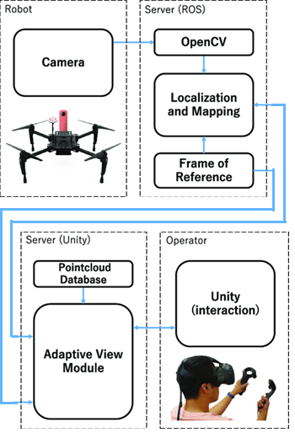
Structure
The internal hardware and software structure of the agent is responsible for making a drone an agent or particularly intelligent agent. The key characteristics of agent structure are
An infrared active camera is installed on the drone which is capable of capturing videos at very high frame rate and in high to low light exposure.
The data from drone is continuously being transferred to central ROS (Robot Central System) which has OpenCV and other image interpretation programs installed on it.
After the estimation of frame of reference, the data is further processed in a server on the Unity game engine platform.
An optional operator is also available to provide manual control in some special case where the intelligent decision making of the agent is being tested.

Slide 5
Environment
Environment | Reason
Inaccessible | Since the action in a traffic surveillance environment does not guarantee the outcome.
Non-deterministic | Environment is real time so it’s hard to determine its state.
Episodic | Agent encounters infinitely many environment states which are changeable, linkage between two states.
Dynamic | Traffic environments are continuously changing so they are dynamic in nature.
Continuous | Traffic environment keeps on changing because its real time so it depicts a continuous environment

Slide 6
Perception
The see function is the agent’s ability to observe its environment, whereas the action function represents the agent’s decision-making process
Output of the see function is a percept:
see: E → Per
which maps environment states to percepts, and action is now a function
action: Per* → A
which maps sequences of percepts to actions
Percepts | Actions
OCR (Read license plate literals) | Save it as internal state and initiate request for details of vehicle when needed.
Recognize (Fake plate) | Alert police, follow the vehicle and coordinate with another agent to tackle the situation.
See (high speeding vehicle) | Note its number and add its challan information in database
See (normal environment) | Do nothing

Slide 7
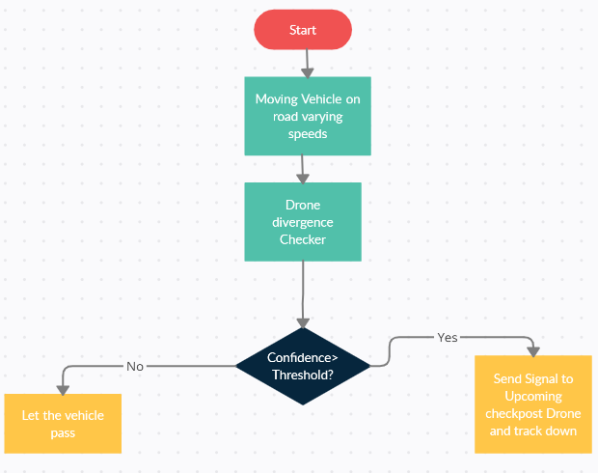
Problem Definition
The primary idea for the system is a matrix of drones mushed together, tracking vehicles. If a vehicle is detected to be violating or more specifically identified as suspicious then the left behind drone sends signal to the upcoming drone and the nearest station so that the vehicle is tracked down in time and stopped if necessary. It is more like an e-challan technique. But in this, there will be drones spooring rather than CCTV.

Slide 8
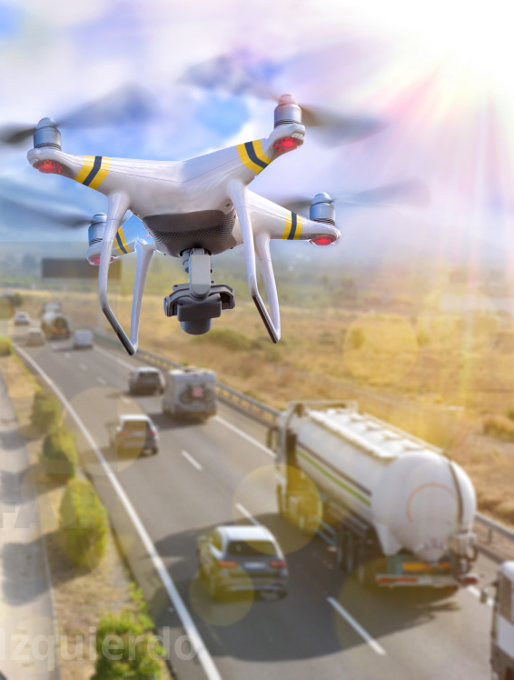
Operational Objectives
Cons
Pros
Detecting a vehicle violating the rule is sometimes tougher and somewhat costly when it comes to street camera or CCTV.
It is difficult to install CCTV all over the city and maintain them with a server room where all the recordings are kept.
If we look just at the hardware installation, it is both difficult and riskier.
Intelligence
Networking
Efficiency
The smart agents or UAV will watch and detect any kind of abnormality and inform the connected agent.
This kind of intelligent behavior with very less consumption of energy and a high source backend networking makes the monitoring system a treat.

Slide 9
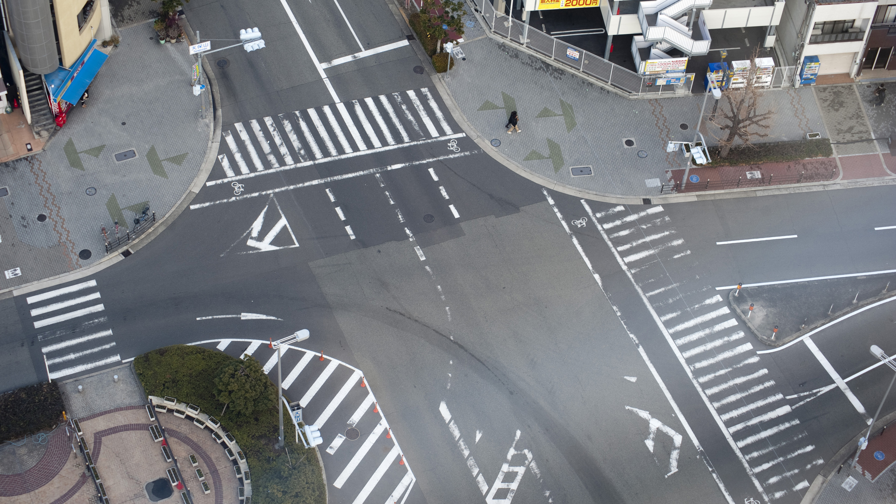
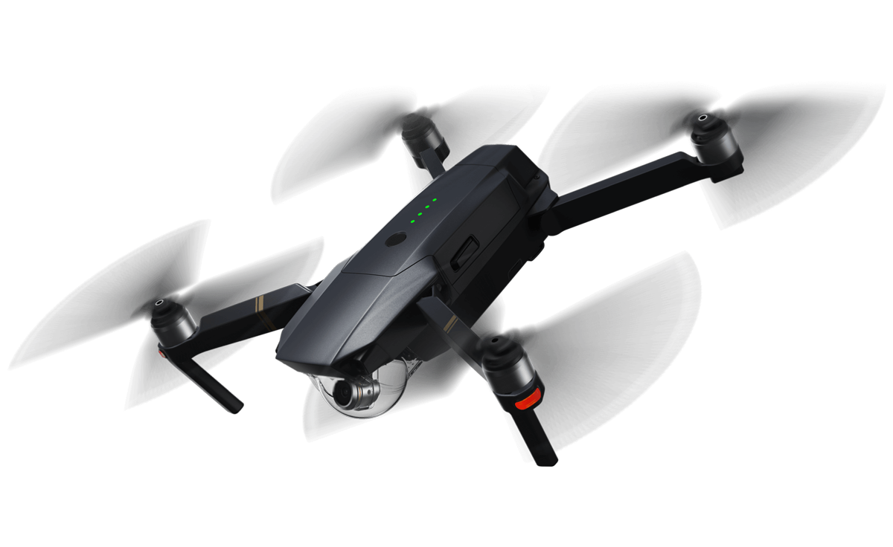
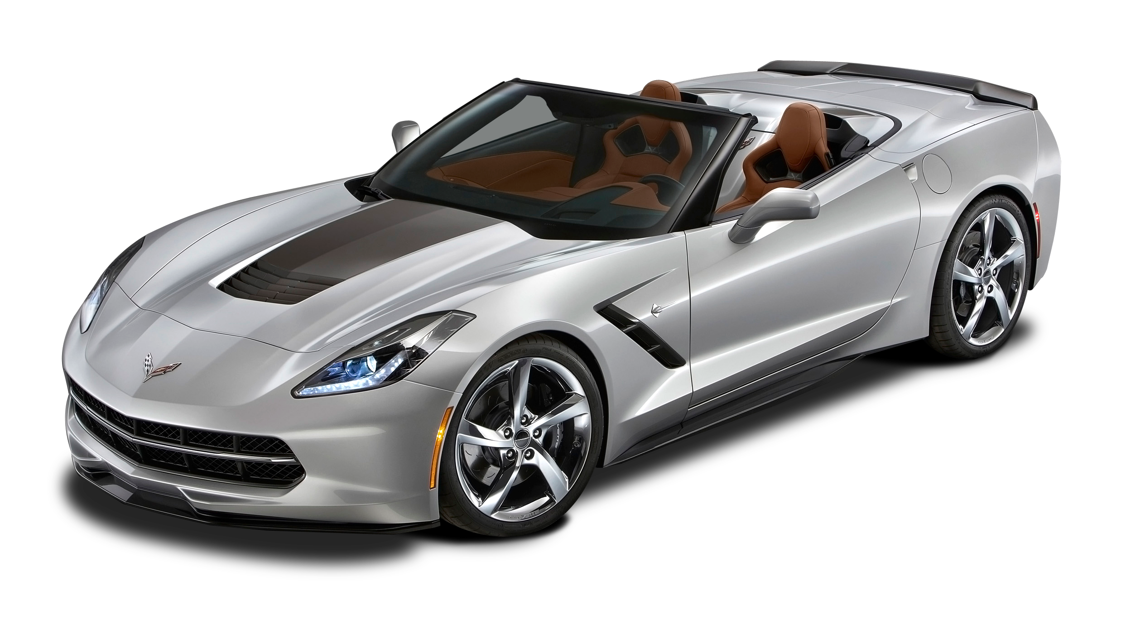
Architecture Diagram
Vehicle type: Sports car License number: ABC 123
Expected location: next quatre after 60sec
Fake license plate detected
OCR read the License number clearly

Slide 10
Native Monitoring vs Drone Based Monitoring System
Native Traffic Monitoring System |  | Drone Based Monitoring System
Technique Name | Efficiency | Technique Name | Efficiency
Traffic Density: Finding the density of vehicles along a road and follow a certain algorithm to direct the vehicles | On spot detection and handling of traffic. Requires good financial investment | Communication Relay Nodes: UAVs can act as relay nodes, which connect disconnected mobile ad hoc network (MANET) clusters. In this case, nodes belonging to different disconnected clusters can communication with each other by using a UAV, which can be placed in a strategic position between the two clusters. | provide robust and reliable connectivity for all of the clusters in the MANET.
Path Optimization: Deciding an optimal path, for an incoming vehicle based on the traffic present at the approaching junction | Real-time analysis of data to find an easy path, but not applicable for all situations where alternative path is not present | Network Gateways: In remote geographic or disaster-stricken areas, one or more UAVs can provide connectivity to backbone networks, communication infrastructure, or the Internet by acting as gateway nodes. | Rapidly and efficiently deployed to perform this task in a very dynamic, and cost-effective manner
Information Chaining System: To inform the vehicles about the traffic along any lane and directing them to change to another route if necessary | Useful in routing of vehicles in an optimized path, but highly developed and error-free system is required else ambiguous situation may arise | Assisted Sensing: A range of UAV applications require multiple collaborative UAVs to sense an area or to inspect an infrastructure using one or more types of sensors like cameras, heat sensors, radiation readers and different gas monitors. | UAVs together in organizing the operations and collectively gathering accurate and reliable information results in accurate and reliable solution.
Green Light Optimization: Use of different logics like fuzzy logic and other simulation techniques to determine the green light length so that every lane is provided with some appropriate time slot | Highly efficient system. Requires large capital for implementation | Distributed Versus Centralized Control: the middleware, which resides between the application and transport layer of each node., the gateway node has additional functions such as data aggregation, UAV to-Infrastructure QoS mapping, and other interface services. | Bottleneck for communication and security and provides safe operations and maintain the fault tolerance mechanism.

Slide 11
Discrete Infrastructure and Techniques
Aerial Imagery | High-Definition Imagery | Mean Shift Tracking | Moving Target Indication
Efficiency: A reasonably accurate estimate of the overall accuracy of the program is achieved by using the threshold of the fast detection algorithm | Efficiency: High-definition air-born imagery is used efficiently for obtaining traffic flow data. | Efficiency: Mean Shift algorithm along with particle filtering can solve the problems caused by fast moving objects in UAV videos. | Efficiency: Performs well on the datasets from the supermarket even with complex 3D structures.
Constraints: Due to its ability to retain nearly all the vehicles in the set while successfully reducing the false positives by half. | Constraints: Vehicles are tracked and traffic parameters are calculated. Keeping in view the adequate Sampling. | Constraints: Small objects are rarely lost which makes this algorithm valuable in UAV videos to track fast small moving objects like vehicles in highways. | Constraints: False alarms and missing targets remain even after the stage two thus some clearly moving objects are not detected.
Analysis: The rotation invariant HoG, did not perform well due to the reflective water that was in the background. | Analysis: Only a small group of vehicles was able to be tracked for a long distance due to 6 sec Video limitation. | Analysis: The Mean Shift can track the objects on time only when the objects are known. | Analysis: The geometrical interpretation of the scene is not well constrained and that causes problems even with a smooth traffic flow on the motorway.

Slide 12
Deductive Reasoning Agent
(x, y, z) starts from (0,0,0) which is starting point for agent on map.
Since drone moves in 3d space so we have to keep track of all 3 dimensions.
A night vision camera will be used by agent for surveillance at night.
Each agent will cover 1000 meters in all directions.
Whenever an agent moves forward it will signal other agents since it’s a multiagent system environment all agents will coordinate with each other to rescue the situation.
These drone agents will be connected to a shared network from where they will fetch data to observe the situation and in which the violation data will be stored so the agents will be in sync.
Each action which depicts will be saved and each agent’s camera will be programmed to detect it.

Slide 13
Deduction Rules
In (x, y, z) ∧ See (person driving with a suspended license) −→ Do (save the record in database) Do (alert police)
In (x, y, z) ∧ See (Fake Plate vehicle) −→ Do (Inform Police) ∧ Do (Save car plate number) ∧ Do (follow it)
In (x, y, z) ∧ See (Speed limit crossing vehicle) −→ Do (Save a challan in database by the car information) ∧ Do (send challan at owner’s address)
In (x, y, z) ∧ See (Swerving) −→ Do (Save a challan in database by the car information) ∧ Do (send challan at owner’s address)
In (x, y, z) ∧ See (not wearing a seat belt) −→ Do (Save a challan in database by the car information) ∧ Do (send challan at owner’s address)
In (x, y, z) ∧ See (not securing young passengers in a child safety seat) −→ Do (Save a challan in database by the car information) ∧ Do (send challan at owner’s address)
In (x, y, z) ∧ See (Talking on a cell phone) −→ Do (Save a challan in database by the car information) ∧ Do (send challan at owner’s address) ∧ Do (alert police)
…..

Slide 14
Conclusion
UAVs can be very useful for traffic monitoring. However, issues with UAV deployment for civil applications must be addressed. Maneuverability and wireless network communication are two of the key points that make unmanned air vehicles more useful than the other methods currently used. The capability of tracking vehicles on the ground and allowance of the transmission and reception of instructions and image and video information to a ground base could be used on board (Radar, Vision, Hybrid), but also on the type of processing (on-board, off-board) of the data in vision sensors.

Slide 15
References
Biswas, S. P., Roy, P., & Patra, N. (2015). Intelligent Traf fi c Monitoring System. October, 535–545. https://doi.org/10.1007/978-81-322-2523-2
Godinho, G. G., França, F. D. O., Freitas, J. M. A., Santos, F. M. L., Prandini, A., Godinho, A. C., & Costa, R. P. D. P. (2015). Resultado do tratamento cirúrgico artroscópico das rerrupturas do manguito rotador do ombro. Revista Brasileira de Ortopedia, 50(1), 89–93. https://doi.org/10.1016/j.rbo.2014.03.007
Kanistras, K., Martins, G., & Rutherford, M. J. (2007). A Survey of Unmanned Aerial Vehicles ( UAVs ) for Traffic Monitoring.
Manager, E. P., Motiani, D., & Commissioner, A. (2016). Unmanned Aerial Vehicle (UAV) Based Traffic Monitoring and Management. DOT National Transportation Integrated Search - ROSA P, August. https://rosap.ntl.bts.gov/view/dot/36710
Wang, J., Liu, J., Meng, J., & Han, M. (2011). Research on an improved mean shift algorithm. Procedia Engineering, 15, 3572–3576. https://doi.org/10.1016/j.proeng.2011.08.669

Slide 16
Thank you

